Slide 1


CSE 3711 -Computer Networks “Application Layer”-
Prof. Dr. A.K.M. Muzahidul Islam
Computer Science & Engineering (CSE)
United International University (UIU)
Summer 2024
Notes:
Introduction:
TCP/IP and OSI Reference Models,
Internet Protocol Stack,
Circuit Switching vs. Packet Switching,
FDMA, TDMA
Physical Media,
Encoding and Decoding,
Delay and Packet Loss.

Slide 2
Outline
2.3 electronic mail
SMTP, POP3, IMAP
2.1 principles of network applications
2.2 Web and HTTP
2.4 DNS
Notes:
Introduction:
TCP/IP and OSI Reference Models,
Internet Protocol Stack,
Circuit Switching vs. Packet Switching,
FDMA, TDMA
Physical Media,
Encoding and Decoding,
Delay and Packet Loss.

Slide 3
Chapter 2: application layer
We study the conceptual and implementation aspects of network applications.
We define key application-layer concepts, including network services required by applications, clients and servers, processes, and transport-layer interfaces.
We examine several network applications in detail:
Web
E-mail, and
DNS.
P2P

Slide 4
2.1 Principals of Network Applications
Suppose you have an idea for a new Network Application. How do you transform the idea into a real-world network application?
Answer: Writing programs that run on different end systems and communicate with each other over the network.
Example A: In the Web application there are two distinct programs that communicate with each other:
The browser program running in the user’s host (desktop, laptop, tablet, smartphone, and so on); and
The Web server program running in the Web server host.
Example B: In a Video on Demand application such as Netflix,
There is a Netflix-provided program running on the user’s smartphone, tablet, or computer; and
Netflix server program running on the Netflix server host. Servers often (but certainly not always) are housed in a data center.

Slide 5
2.1 Principals of Network Applications
Thus, when developing a new application,
Write software that will run on multiple end systems.
The Languages of the software,
C, Java, or Python.
Importantly, you do not need to write software that runs on network-core devices e.g. routers or link-layer switches.
Even if you wanted to write application software for these network-core devices, you wouldn’t be able to do so.
Note that Network-core devices do not function at the application layer
But instead function at lower layers— specifically at the network layer and below.

Slide 6
Some Network Apps
e-mail
web
text messaging
remote login
P2P file sharing
multi-user network games
streaming stored video (YouTube, Hulu, Netflix)
voice over IP (e.g., Skype)
real-time video conferencing
social networking
search
…
…

Slide 7

















Creating a network app
application
transport
network
data link
physical
Write programs that:
run on (different) end systems
communicate over network
e.g., web server software communicates with browser software
No need to write software for network-core devices
network-core devices do not run user applications
applications on end systems allows for rapid app development, propagation
application
transport
network
data link
physical
application
transport
network
data link
physical
Fig. Communication for a network application takes place between end systems at the application layer

Slide 8
Application architectures
Application’s architecture is distinctly different from the network architecture (e.g., 5-layer Architecture).
The Network Architecture is fixed and provides a specific set of services to applications.
The Application architecture, is designed by the application developer and dictates how the application is structured over the various end systems.
There are two predominant architectural paradigms used in modern network applications:
Client-server
Peer-to-peer (P2P)
Notes:
There are two predominant architectural paradigms used in modern network applications

Slide 9
Client-server architecture
In a client-server architecture, there is
an always-on host, called the server,
which services requests from many
other hosts, called clients.
Server:
always-on host
permanent IP address
data centers for scaling
E.g., Web Server
Clients:
Do not communicate directly with each other
e.g. browsers don’t talk to each other.
communicate with server
may be intermittently/irregularly connected
may have dynamic IP addresses
client/server

Slide 10
In a client-server application, a single-server host is incapable of keeping up with all the requests from clients.
A popular social-networking site can quickly become overwhelmed if it has only one server handling all of its requests.
A data center, housing a large number of hosts, is often used to create a powerful virtual server.
For example,
Search engines (e.g., Google, Bing, Baidu),
Internet commerce (e.g., Amazon, eBay, Alibaba),
Web-based e-mail (e.g., Gmail and Yahoo Mail),
Social media (e.g., Facebook, Instagram, Twitter, and WeChat), etc.
Run in one or more data centers.
Google has 19 data centers distributed around the world,
To collectively handle search, YouTube, Gmail, and other services.
A data center can have hundreds of thousands of servers, which must be powered and maintained.

Slide 11
P2P architecture
In a P2P architecture, there is minimal (or no) reliance on dedicated servers in data centers.
Instead the application exploits direct communication between pairs of intermittently connected hosts, called peers.
No always-on server
Arbitrary end systems directly communicate
Peers request service from other peers, provide service in return to other peers
Self scalability – new peers bring new service capacity, as well as new service demands
For example, in a P2P file-sharing application, although each peer generates workload by requesting files, each peer also adds service capacity to the system by distributing files to other peers.
Peers are intermittently connected and change IP addresses
complex management
peer-peer

Slide 12
Processes communicating
It is not actually programs but processes that communicate
A process:
is a program running within an end system or host
Within same host, two processes communicate using inter-process communication (defined by OS)
Processes in different hosts communicate by exchanging messages
clients, servers
A network application consists of pairs of processes that send messages to each other over a network.
client process: process that initiates communication
server process: process that waits to be contacted
With the Web, a browser is a client process and a Web server is a server process.
With P2P file sharing, the peer that is downloading the file is labeled as the client, and the peer that is uploading the file is labeled as the server.

Slide 13

Sockets
Message sent from one process to another must go through the underlying network.
A process sends messages into, and receives messages from, the network through a software interface called a socket.
A process is analogous to a house and its socket is analogous to its door.
When a process wants to send a message to another process on another host, it pushes the message out its door (socket).
Once the message arrives at the destination host, the message passes through the receiving process’s door (socket), and the receiving process then acts on the message.
Socket is the interface between application and transport layers within a host and
Socket is referred to as Application Programming Interface (API) between application and network.
controlled by
app developer
application
socket
application
process
process
transport
transport
controlled
by OS
network
network
link
Internet
link
physical
physical

Slide 14
Addressing processes
For a process running on one host to send packets to a process running on another host, the receiving process needs to have an address.
To identify the receiving process, two pieces of information need to be specified:
(1) Address of the host i.e. IP address
(2) Identifier that specifies the receiving process i.e. the receiving socket in the destination host.
A destination port number serves this purpose
Q: does IP address of host on which process runs suffice for identifying the process?
identifier includes both IP address and port numbers associated with process on host.
example port numbers:
HTTP server: 80
mail server: 25
to send HTTP message to gaia.cs.umass.edu web server:
IP address: 128.119.245.12
port number: 80
more shortly…
A: no, many processes can be running on same host

Slide 15
App-layer protocol defines
The application at the sending side pushes messages through the socket
types of messages exchanged,
e.g., request, response
message syntax:
what fields in messages & how fields are described
message semantics
meaning of information in fields
rules for when and how processes send & respond to messages
open protocols:
defined in RFCs
allows for interoperability
e.g., HTTP, SMTP
proprietary protocols:
e.g., Skype

Slide 16
What transport service does an app need?
The services that a transport-layer protocol can offer to applications can be classified:
reliable data transfer, throughput, timing, and security.
Data integrity
some apps (e.g., file transfer, web transactions) require 100% reliable data transfer
other apps (e.g., audio) can tolerate some loss
Timing
some apps (e.g., Internet telephony, interactive games) require low delay to be “effective”
Throughput
some apps (e.g., multimedia) require minimum amount of throughput to be “effective”
other apps (“elastic apps”) make use of whatever throughput they get
Security
encryption, data integrity, …
Notes:
Throughput is a measure of how many units of information a system can process in a given amount of time.

Slide 17
Transport service requirements: common apps
application
file transfer
e-mail
Web documents
real-time audio/video
stored audio/video
interactive games
text messaging
data loss
no loss
no loss
no loss
loss-tolerant
loss-tolerant
loss-tolerant
no loss
throughput
elastic
elastic
elastic
audio: 5kbps-1Mbps
video:10kbps-5Mbps
same as above
few kbps up
elastic
time sensitive
no
no
no
yes, 100’s msec
yes, few secs
yes, 100’s msec
yes and no

Slide 18
Internet transport protocols services
The Internet (TCP/ IP networks) makes two transport protocols available to applications : UDP and TCP.
When create a new network application for the Internet, one of the first decisions you have to make is whether to use UDP or TCP.
TCP service:
reliable transport between sending and receiving process
flow control: sender won’t overwhelm receiver
congestion control: control sender when network overloaded
does not provide: timing, minimum throughput guarantee, security
connection-oriented: setup required between client and server processes
UDP service:
unreliable data transfer between sending and receiving process
does not provide: reliability, flow control, congestion control, timing, throughput guarantee, security, or connection setup,
Q: why bother? Why is there a UDP?

Slide 19
Internet apps: application, transport protocols
application
layer protocol
SMTP [RFC 2821]
Telnet [RFC 854]
HTTP [RFC 2616]
FTP [RFC 959]
HTTP (e.g., YouTube), RTP [RFC 1889]
SIP, RTP, proprietary
(e.g., Skype)
underlying
transport protocol
TCP
TCP
TCP
TCP
TCP or UDP
TCP or UDP
application
e-mail
remote terminal access
Web
file transfer
streaming multimedia
Internet telephony

Slide 20


Slide 21
Securing TCP
Neither TCP nor UDP provides any
encryption—the data that the sending
process passes into its socket is the
same data that travels over the
network to the destination process.
TCP & UDP
no encryption
cleartext passwords sent into socket traverse Internet in cleartext
SSL
provides encrypted TCP connection
data integrity
end-point authentication
TLS
The Internet community has developed
an enhancement for TCP, called Transport
Layer Security (TLS) [RFC 5246].
TCP-enhanced-with-TLS not only does
everything that traditional TCP does but
also provides critical process-to-process
security services, including encryption,
data integrity, and end-point
authentication.
SSL is at app layer
apps use SSL libraries, that “talk” to TCP
SSL socket API
cleartext passwords sent into socket traverse Internet encrypted
see Chapter 8

Slide 22
Chapter 2: outline
2.1 principles of network applications
2.2 Web and HTTP
2.3 electronic mail
SMTP, POP3, IMAP
2.4 DNS
2.5 P2P applications
2.6 video streaming and content distribution networks
2.7 socket programming with UDP and TCP

Slide 23
Web and HTTP
First, a review…
web page consists of objects
object can be HTML file, JPEG image, Java applet, audio file,…
web page consists of base HTML-file which includes several referenced objects
each object is addressable by a URL, e.g.,
www.someschool.edu/someDept/pic.gif
host name
path name

Slide 24

HTTP overview
HTTP: hypertext transfer protocol
Web’s application layer protocol
client/server model
client: browser that requests, receives, (using HTTP protocol) and “displays” Web objects
server: Web server sends (using HTTP protocol) objects in response to requests
HTTP request
PC running
Firefox browser
HTTP response
HTTP request
server
running
Apache Web
server
HTTP response
iPhone running
Safari browser

Slide 25
HTTP overview (continued)
uses TCP:
client initiates TCP connection (creates socket) to server, port 80
server accepts TCP connection from client
HTTP messages (application-layer protocol messages) exchanged between browser (HTTP client) and Web server (HTTP server)
TCP connection closed
HTTP is “stateless”
server maintains no information about past client requests
aside
protocols that maintain “state” are complex!
past history (state) must be maintained
if server/client crashes, their views of “state” may be inconsistent, must be reconciled

Slide 26
HTTP connections
non-persistent HTTP
at most one object sent over TCP connection
connection then closed
downloading multiple objects required multiple connections
persistent HTTP
multiple objects can be sent over single TCP connection between client, server

Slide 27
Non-persistent HTTP
suppose user enters URL:
(contains text,
references to 10
jpeg images)
www.someSchool.edu/someDepartment/home.index
1a. HTTP client initiates TCP connection to HTTP server (process) at www.someSchool.edu on port 80
1b. HTTP server at host www.someSchool.edu waiting for TCP connection at port 80. “accepts” connection, notifying client
2. HTTP client sends HTTP request message (containing URL) into TCP connection socket. Message indicates that client wants object someDepartment/home.index
3. HTTP server receives request message, forms response message containing requested object, and sends message into its socket
time

Slide 28
Non-persistent HTTP (cont.)
4. HTTP server closes TCP connection.
5. HTTP client receives response message containing html file, displays html. Parsing html file, finds 10 referenced jpeg objects
time
6. Steps 1-5 repeated for each of 10 jpeg objects

Slide 29
Non-persistent HTTP: response time
RTT (Round Trip Time): Time requires for a small packet to travel from client to server and back
HTTP response time:
one RTT to initiate TCP connection
one RTT for HTTP request and first few bytes of HTTP response to return
file transmission time
non-persistent HTTP response time =
2RTT+ file transmission time
initiate TCP
connection
RTT
request
file
RTT
time to
transmit
file
file
received
time
time

Slide 30
Persistent HTTP
non-persistent HTTP issues:
requires 2 RTTs per object
OS overhead for each TCP connection
browsers often open parallel TCP connections to fetch referenced objects
persistent HTTP:
server leaves connection open after sending response
subsequent HTTP messages between same client/server sent over open connection
client sends requests as soon as it encounters a referenced object
as little as one RTT for all the referenced objects
Notes:
https://bdren.zoom.us/j/63642678945

Slide 31
Examples
Questions : Assume that you have base HTML file with 30 embedded images, images & base file are small enough to fit in one TCP segment. How many RTT are required to retrieve base file & images under-following condition : (i) Non-Persistent connection without parallel connection (ii) Non-persistent connection with 10 parallel connection (iii) Persistent connection without pipe-lining (iv) Persistent connection with pipe-lining (Assume RTT dominates all other time)
Explanation : 2RTT is the initial required connection one for TCP connection and one for HTML base file.
Total time = 2RTT + transmit time
(i) Non-Persistent connection with no parallel connection : Here for each image 2 RTT are required one for TCP connection and one for image to send. So transmit time for 30 images = 2*(30 RTT) = 60 RTT Total time = 2 RTT+60 RTT = 62RTT
(ii) Non-persistent connection with 10 parallel connection : Here 10 images can be send simultaneously. So for 30 images it required -> 2*(30/10) = 6RTT Total time = 2 RTT + 6 RTT = 8RTT
(iii) Persistent connection without pipelining : Here TCP connection is required again and again. So for 30 images it requires -> 30 RTTs Total time = 2 RTT + 30 RTT = 32RTT
(iv) Persistent connection with pipe-lining : Since it is Persistent connection TCP connection is not required again and again. Pipe-lining means in one packet only images which can fit, can be send. In Pipe-lining connection we can send all images in 1RTT. Total time = 2 RTT + 1 RTT = 3RTT
https://www.geeksforgeeks.org/http-non-persistent-persistent-connection-set-2/

Slide 32
Comparison
Persistent e.g., http 1.1
1 RTT for TCP Connection
1 RTT for the Base File
Pipe-lining
1 RTT for all objects
Non-Pipe-lining
1 RTT for each object
Non-Persistent e.g., http 1.0
1 RTT for TCP Connection
1 RTT for the Base File
For each Object do
1 RTT for TCP Connection
1 RTT for the Object
The original version of HTTP is called HTTP/1.0 and dates back to the early 1990’s [RFC 1945].
As of 2020, the majority of HTTP transactions take place over HTTP/1.1 [RFC 7230].
However, increasingly browsers and Web servers also support a new version of HTTP called HTTP/2 [RFC 7540].
Notes:
Example Reference: HTTP Non-Persistent & Persistent Connection | Set 1 – GeeksforGeeks

Slide 33
HTTP/2
Key goal: decreased delay in multi-object HTTP requests
HTTP1.1: introduced multiple, pipelined GETs over single TCP connection
server responds in-order (FCFS: first-come-first-served scheduling) to GET requests
with FCFS, small object may have to wait for transmission (head-of-line (HOL) blocking) behind large object(s)
loss recovery (retransmitting lost TCP segments) stalls object transmission
Notes:
t’

Slide 34
HTTP/2
Key goal: decreased delay in multi-object HTTP requests
HTTP/2: [RFC 7540, 2015] increased flexibility at server in sending objects to client:
methods, status codes, most header fields unchanged from HTTP 1.1
transmission order of requested objects based on client-specified object priority (not necessarily FCFS)
push unrequested objects to client
divide objects into frames, schedule frames to mitigate HOL blocking
Notes:
t’

Slide 35

HTTP/2: mitigating HOL blocking
HTTP 1.1: client requests 1 large object (e.g., video file) and 3 smaller objects
server
GET O₄
GET O₃
GET O₂
GET O₁
object data requested
client
O₁
O₂
O₁
O₂
O₃
O₃
O₄
O₄
objects delivered in order requested: O₂, O₃, O₄ wait behind O₁
Notes:
t’

Slide 36
HTTP/2: mitigating HOL blocking
HTTP/2: objects divided into frames, frame transmission interleaved
server
GET O₄
GET O₃
GET O₂
object data requested
GET O₁
client
O₂
O₄
O₃
O₁
O₂
O₃
O₄
O₁
O₂, O₃, O₄ delivered quickly, O₁ slightly delayed
Notes:
shortest job first: decreased average delay!

Slide 37
HTTP/2 to HTTP/3
HTTP/2 over single TCP connection means:
recovery from packet loss still stalls all object transmissions
as in HTTP 1.1, browsers have incentive to open multiple parallel TCP connections to reduce stalling, increase overall throughput
no security over vanilla TCP connection
HTTP/3: adds security, per object error- and congestion-control (more pipelining) over UDP
more on HTTP/3 in transport layer
Notes:
t’

Slide 39
HTTP request message
two types of HTTP messages: request, response
HTTP request message:
ASCII (human-readable format)
carriage return character
request line
(GET, POST,
HEAD commands)
line-feed character
GET /index.html HTTP/1.1\r\n
Host: www-net.cs.umass.edu\r\n
User-Agent: Firefox/3.6.10\r\n
Accept: text/html,application/xhtml+xml\r\n
Accept-Language: en-us,en;q=0.5\r\n
Accept-Encoding: gzip,deflate\r\n
Accept-Charset: ISO-8859-1,utf-8;q=0.7\r\n
Keep-Alive: 115\r\n
Connection: keep-alive\r\n
\r\n
header
lines
carriage return,
line feed at start
of line indicates
end of header lines
* Check out the online interactive exercises for more examples: http://gaia.cs.umass.edu/kurose_ross/interactive/

Slide 40
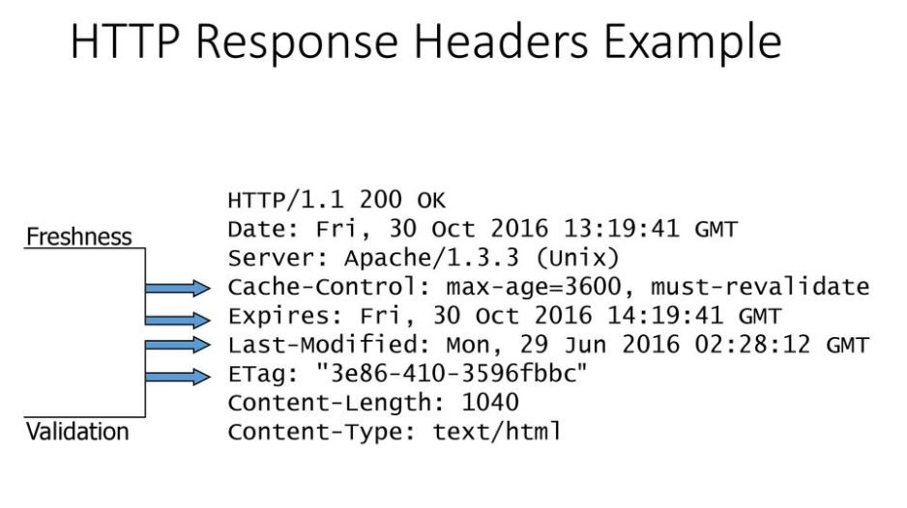
HTTP response message

Slide 41
User-server state: cookies
It is desirable for a Web site to identify users:
either because the server wishes to restrict user access or
because it wants to serve content as a function of the user identity.
many Web sites use cookies
four components:
1) cookie header line of HTTP response message
2) cookie header line in next HTTP request message
3) cookie file kept on user’s host, managed by user’s browser
4) back-end database at Web site
example:
Susan always access Internet from PC
visits specific e-commerce site for first time
when initial HTTP requests arrives at site, site creates:
unique ID
entry in backend database for ID

Slide 42
Cookies: keeping “state” (cont.)
client
server
ebay 8734
usual http request msg
Amazon server
creates ID
1678 for user
cookie file
usual http response
set-cookie: 1678
backend
database
create
entry
ebay 8734
amazon 1678
usual http request msg
cookie: 1678
cookie-
specific
action
access
usual http response msg
one week later:
access
ebay 8734
amazon 1678
usual http request msg
cookie: 1678
cookie-
specific
action
usual http response msg

Slide 43
Cookies (continued)
aside
what cookies can be used for:
authorization
shopping carts
recommendations
user session state (Web e-mail)
cookies and privacy:
cookies permit sites to learn a lot about you
you may supply name and e-mail to sites
how to keep “state”:
protocol endpoints: maintain state at sender/receiver over multiple transactions
cookies: http messages carry state

Slide 44

Web caches (proxy server)
Goal: satisfy client request without involving origin server
user sets browser: Web accesses via cache
browser sends all HTTP requests to cache
If object in cache: cache returns object
else cache requests object from origin server, store copy and then returns object to client
proxy
server
HTTP request
HTTP request
client
origin
server
HTTP response
HTTP response
HTTP request
HTTP response
client
origin
server

Slide 45
More about Web caching
cache acts as both client and server
server for original requesting client
client to origin server
typically cache is installed by ISP (university, company, residential ISP)
why Web caching?
reduce response time for client request
reduce traffic on an institution’s access link
Internet dense with caches: enables “poor” content providers to effectively deliver content (so too does P2P file sharing)

Slide 47
Chapter 2: outline
2.1 principles of network applications
2.2 Web and HTTP
2.3 electronic mail
SMTP, POP3, IMAP
2.4 DNS
2.5 P2P applications
2.6 video streaming and content distribution networks
2.7 socket programming with UDP and TCP

Slide 48
Electronic mail
outgoing
message queue
user mailbox
Three major components:
user agents
mail servers
simple mail transfer protocol: SMTP
User Agent
a.k.a. “mail reader”
composing, editing, reading mail messages
e.g., Outlook, Thunderbird, iPhone mail client
outgoing, incoming messages stored on server
user
agent
mail
server
user
agent
SMTP
mail
server
user
agent
SMTP
SMTP
user
agent
mail
server
user
agent
user
agent

Slide 49
Electronic mail: mail servers
mail servers:
mailbox contains incoming messages for user
message queue of outgoing (to be sent) mail messages
SMTP protocol between mail servers to send email messages
client: sending mail server
“server”: receiving mail server
user
agent
mail
server
user
agent
SMTP
mail
server
user
agent
SMTP
SMTP
user
agent
mail
server
user
agent
user
agent

Slide 50
Electronic Mail: SMTP [RFC 2821]
uses TCP to reliably transfer email message from client to server, port 25
direct transfer: sending server to receiving server
three phases of transfer
handshaking (greeting)
transfer of messages
closure
command/response interaction (like HTTP)
commands: ASCII text
response: status code and phrase
messages must be in 7-bit ASCII

Slide 51
SMTP RFC (5321)
“client”
SMTP server
“server”
SMTP server
initiate TCP
connection
RTT
TCP connection
initiated
220
SMTP handshaking
HELO
250 Hello
SMTP transfers
time

Slide 52


Scenario: Alice sends message to Bob
1) Alice uses UA to compose message “to” bob@someschool.edu
2) Alice’s UA sends message to her mail server; message placed in message queue
3) client side of SMTP opens TCP connection with Bob’s mail server
4) SMTP client sends Alice’s message over the TCP connection
5) Bob’s mail server places the message in Bob’s mailbox
6) Bob invokes his user agent to read message
user
agent
mail
server
user
agent
1
mail
server
2
3
6
4
Alice’s mail server
5
Bob’s mail server

Slide 53
Mail message format
SMTP: protocol for exchanging email messages
RFC 822: standard for text message format:
header lines, e.g.,
To:
From:
Subject:
different from SMTP MAIL FROM, RCPT TO: commands!
Body: the “message”
ASCII characters only
header
blank
line
body

Slide 54
Mail access protocols
user
agent
mail access
protocol
user
agent
SMTP
SMTP
(e.g., POP,
IMAP)
sender’s mail
server
receiver’s mail
server
SMTP: delivery/storage to receiver’s server
mail access protocol: retrieval from server
POP: Post Office Protocol [RFC 1939]: authorization, download
IMAP: Internet Mail Access Protocol [RFC 1730]: more features, including manipulation of stored messages on server
HTTP: gmail, Hotmail, Yahoo! Mail, etc.

Slide 55
Chapter 2: outline
2.1 principles of network applications
2.2 Web and HTTP
2.3 electronic mail
SMTP, POP3, IMAP
2.4 DNS
2.5 P2P applications
2.6 video streaming and content distribution networks
2.7 socket programming with UDP and TCP

Slide 56
DNS: domain name system
people: many identifiers:
SSN, name, passport #
Internet hosts, routers:
IP address (32 bit) - used for addressing datagrams
“name”, e.g., www.yahoo.com - used by humans
Q: how to map between IP address and name, and vice versa ?
Domain Name System:
distributed database implemented in hierarchy of many name servers
application-layer protocol: hosts, name servers communicate to resolve address / names translation (i.e., allows hosts to query the distributed database)
DNS servers are often UNIX Machines
DNS servers run Berkeley Internet Name Domain, namely BIND software
DNS protocol runs over UDP and uses port 53
note: core Internet function, implemented as application-layer protocol
complexity at network’s “edge”

Slide 57
DNS Overview
When a browser, running on some user’s host, requests the URL www.someschool.edu/index.html.
To be able to send an HTTP request message to the Web server www.someschool.edu, the user must obtain the IP address.
This is done as follows:
1. The same user machine runs the client side of the DNS application.
2. The browser extracts the hostname, www.someschool.edu, from the URL and passes the hostname to the client side of the DNS application.
3. DNS client sends a query containing the hostname to a DNS server.
4. The DNS client eventually receives a reply, which includes the IP address for the hostname.
5. Once the browser receives the IP address from DNS, it can initiate a TCP connection to the HTTP server process located at port 80 at that IP

Slide 58
DNS: services, structure
DNS services
hostname to IP address translation
host aliasing
A host with a complicated hostname can have one or more alias names.
canonical, alias names
Example:
mail server aliasing
load distribution
replicated Web servers: many IP addresses correspond to one name
why not centralize DNS?
single point of failure
traffic volume
distant centralized database
maintenance
A: doesn‘t scale!

Slide 59
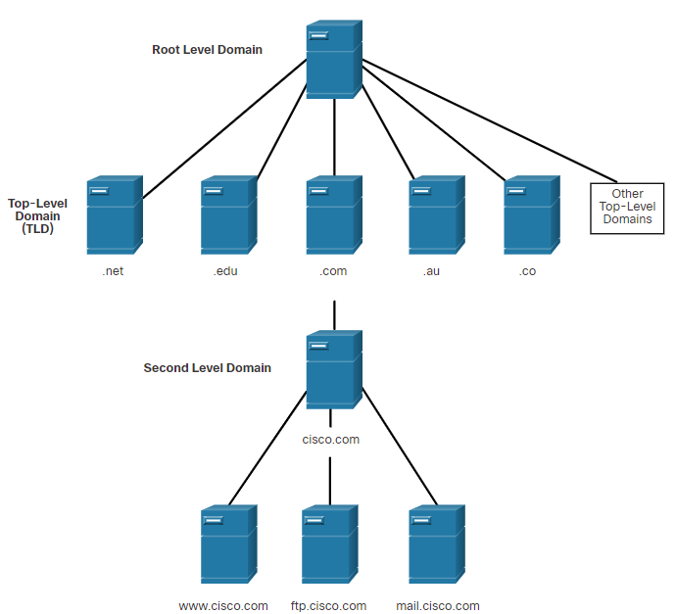
DNS
The DNS Domain Hierarchy
DNS consists of a hierarchy of generic top-level domains and numerous country-level domains.
The second-level domains are represented by a domain name that is followed by a top-level domain.
Subdomains are found at the next level of the DNS hierarchy and represent some division of the second-level domain.
Fourth level domain can represent a host in a subdomain.
Top-level domains represent either the type of organization or country of origin. Examples: (.org) - a non-profit organization, (.au) – Australia.
DNS Hierarchy
Notes:
10– Network Services
10.2 – DNS
10.2.2- The DNS Domain Hierarchy

Slide 60
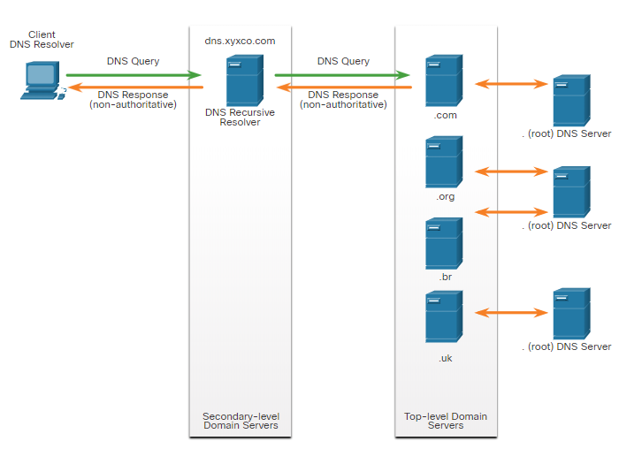
DNS
The DNS Lookup Process
To resolve a name to an IP address, the resolver, will first check its local DNS cache. If the mapping is not found, a query will be issued to the DNS server .
If the mapping is not found there, the DNS server will query other higher-level DNS servers that are authoritative for the top-level domain in order to find the mapping. These are known as recursive queries.
The caching DNS servers can resolve recursive queries without forwarding the queries to higher level servers.
If a server requires data for a zone, it will request a transfer of that data from an authoritative server for that zone. The process of transferring DNS data between servers is known as zone transfer.
Notes:
10– Network Services
10.2 – DNS
10.2.3 - The DNS Lookup Process

Slide 61
DNS: a distributed, hierarchical database
Root DNS Servers
…
…
com DNS servers
org DNS servers
edu DNS servers
yahoo.com
DNS servers
pbs.org
DNS servers
poly.edu
DNS servers
umass.edu
DNS servers
amazon.com
DNS servers
client wants IP for www.amazon.com; 1st approximation:
client queries root server to find com DNS server
client queries .com DNS server to get amazon.com DNS server
client queries amazon.com DNS server to get IP address for www.amazon.com

Slide 62
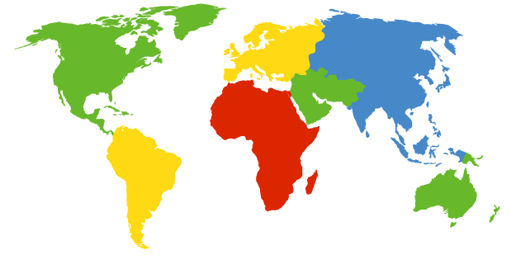
DNS: root name servers
contacted by local name server that can not resolve name
root name server:
contacts authoritative name server if name mapping not known
gets mapping
returns mapping to local name server
c. Cogent, Herndon, VA (5 other sites)
d. U Maryland College Park, MD
h. ARL Aberdeen, MD
j. Verisign, Dulles VA (69 other sites )
k. RIPE London (17 other sites)
i. Netnod, Stockholm (37 other sites)
e. NASA Mt View, CA
f. Internet Software C.
Palo Alto, CA (and 48 other sites)
m. WIDE Tokyo
(5 other sites)
13 logical root name “servers” worldwide
each “server” replicated many times
a. Verisign, Los Angeles CA
(5 other sites)
b. USC-ISI Marina del Rey, CA
l. ICANN Los Angeles, CA
(41 other sites)
g. US DoD Columbus, OH (5 other sites)

Slide 63
TLD, authoritative servers
top-level domain (TLD) servers:
responsible for com, org, net, edu, aero, jobs, museums, and all top-level country domains, e.g.: uk, fr, ca, jp
Network Solutions maintains servers for .com TLD
Educause for .edu TLD
authoritative DNS servers:
organization’s own DNS server(s), providing authoritative hostname to IP mappings for organization’s named hosts
can be maintained by organization or service provider

Slide 64
Local DNS name server
does not strictly belong to hierarchy
each ISP (residential ISP, company, university) has one
also called “default name server”
when host makes DNS query, query is sent to its local DNS server
has local cache of recent name-to-address translation pairs (but may be out of date!)
acts as proxy, forwards query into hierarchy

Slide 65
DNS name resolution example
root DNS server
2
host at cis.poly.edu wants IP address for gaia.cs.umass.edu
3
TLD DNS server
4
5
iterated query:
contacted server replies with name of server to contact
“I don’t know this name, but ask this server”
local DNS server
dns.poly.edu
7
6
1
8
authoritative DNS server
dns.cs.umass.edu
requesting host
cis.poly.edu
gaia.cs.umass.edu

Slide 66
DNS name resolution example
root DNS server
2
3
recursive query:
puts burden of name resolution on contacted name server
heavy load at upper levels of hierarchy?
7
6
TLD DNS
server
local DNS server
dns.poly.edu
5
4
1
8
authoritative DNS server
dns.cs.umass.edu
requesting host
cis.poly.edu
gaia.cs.umass.edu

Slide 67
DNS: caching, updating records
once (any) name server learns mapping, it caches mapping
cache entries timeout (disappear) after some time (TTL)
TLD servers typically cached in local name servers
thus root name servers not often visited
cached entries may be out-of-date (best effort name-to-address translation!)
if name host changes IP address, may not be known Internet-wide until all TTLs expire
update/notify mechanisms proposed IETF standard
RFC 2136

Slide 68
DNS records
DNS: distributed database storing resource records (RR)
RR format: (name, value, type, ttl)
type=A
name is hostname
value is IP address
type=CNAME
name is alias name for some “canonical” (the real) name
www.ibm.com is really
servereast.backup2.ibm.com
value is canonical name
type=NS
name is domain (e.g., foo.com)
value is hostname of authoritative name server for this domain
type=MX
value is name of mailserver associated with name

Slide 69
DNS
DNS Message Format (Contd.)
Sections of DNS message format :
DNS message section | Description
Question | The question for the server. It contains the domain name to be resolved, the class of domain, and the query type.
Answer | The DNS resource record, or RR, for the query including the resolved IP address depending on the RR type.
Authority | Contains the RRs for the domain authority.
Additional | Relevant to query responses only. Consists of RRs that hold additional information that will make query resolution more efficient
Notes:
10– Network Services
10.2 – DNS
10.2.4 - DNS Message Format

Slide 70
DNS protocol, messages
query and reply messages, both with same message format
2 bytes
2 bytes
message header
identification: 16 bit # for query, reply to query uses same #
flags:
query or reply
recursion desired
recursion available
reply is authoritative
identification
flags
# questions
# answer RRs
# authority RRs
# additional RRs
questions (variable # of questions)
answers (variable # of RRs)
authority (variable # of RRs)
additional info (variable # of RRs)

Slide 71
DNS protocol, messages
2 bytes
2 bytes
identification
flags
# questions
# answer RRs
# authority RRs
# additional RRs
name, type fields
for a query
questions (variable # of questions)
RRs in response
to query
answers (variable # of RRs)
records for
authoritative servers
authority (variable # of RRs)
additional “helpful”
info that may be used
additional info (variable # of RRs)

Slide 72
Inserting records into DNS
example: new startup “Network Utopia”
register name networkuptopia.com at DNS registrar (e.g., Network Solutions)
provide names, IP addresses of authoritative name server (primary and secondary)
registrar inserts two RRs into .com TLD server: (networkutopia.com, dns1.networkutopia.com, NS)
(dns1.networkutopia.com, 212.212.212.1, A)
create authoritative server locally with IP address 212.212.212.1
type A record for www.networkuptopia.com;
type MX record for networkutopia.com

Slide 73
DNS security
DDoS attacks
bombard root servers with traffic
not successful to date
traffic filtering
local DNS servers cache IPs of TLD servers, allowing root server bypass
bombard TLD servers
potentially more dangerous
Spoofing attacks
intercept DNS queries, returning bogus replies
DNS cache poisoning
RFC 4033: DNSSEC authentication services

Slide 74

Application Layer: Overview
P2P applications
video streaming and content distribution networks
socket programming with UDP and TCP
Principles of network applications
Web and HTTP
E-mail, SMTP, IMAP
The Domain Name System DNS

Slide 75









Peer-to-peer (P2P) architecture
no always-on server
arbitrary end systems directly communicate
peers request service from other peers, provide service in return to other peers
self scalability – new peers bring new service capacity, and new service demands
peers are intermittently connected and change IP addresses
complex management
examples: P2P file sharing (BitTorrent), streaming (KanKan), VoIP (Skype)
mobile network
national or global ISP
local or regional ISP
home network
content
provider
network
datacenter
network
enterprise
network

Slide 76
File distribution: client-server vs P2P
Q: how much time to distribute file (size F) from one server to N peers?
peer upload/download capacity is limited resource
u_{s}: server upload capacity
d_{i}: peer i download capacity
file, size F
u_{s}
u₁
d₁
u₂
server
d₂
d_{i}
u_{N}
network (with abundant
bandwidth)
u_{i}
d_{N}
u_{i}: peer i upload capacity

Slide 77

File distribution time: client-server
server transmission: must sequentially send (upload) N file copies:
time to send one copy: F/u_{s}
time to send N copies: NF/u_{s}
F
u_{s}
d_{i}
network
client: each client must download file copy
d_{min} = min client download rate
min client download time: F/d_{min}
u_{i}
time to distribute F
to N clients using
client-server approach
D_{c-s} > max{NF/u_{s,},F/d_{min}}
increases linearly in N

Slide 78
File distribution time: P2P
server transmission: must upload at least one copy:
time to send one copy: F/u_{s}
F
u_{s}
client: each client must download file copy
min client download time: F/d_{min}
d_{i}
network
u_{i}
clients: as aggregate must download NF bits
max upload rate (limiting max download rate) is u_{s} + Σu_{i}
time to distribute F
to N clients using
P2P approach
D_{P2P} > max{F/u_{s,},F/d_{min,},NF/(u_{s} + Σu_{i})}
increases linearly in N …
… but so does this, as each peer brings service capacity

Slide 79
Client-server vs. P2P: example
client upload rate = u, F/u = 1 hour, u_{s} = 10u, d_{min} ≥ u_{s}

Slide 80




P2P file distribution: BitTorrent
file divided into 256Kb chunks
peers in torrent send/receive file chunks
tracker: tracks peers
participating in torrent
torrent: group of peers exchanging chunks of a file
Alice arrives …
… obtains list
of peers from tracker
… and begins exchanging
file chunks with peers in torrent

Slide 81


P2P file distribution: BitTorrent
peer joining torrent:
has no chunks, but will accumulate them over time from other peers
registers with tracker to get list of peers, connects to subset of peers (“neighbors”)
while downloading, peer uploads chunks to other peers
peer may change peers with whom it exchanges chunks
churn: peers may come and go
once peer has entire file, it may (selfishly) leave or (altruistically) remain in torrent

Slide 82
BitTorrent: requesting, sending file chunks
Requesting chunks:
at any given time, different peers have different subsets of file chunks
periodically, Alice asks each peer for list of chunks that they have
Alice requests missing chunks from peers, rarest first
Sending chunks: tit-for-tat
Alice sends chunks to those four peers currently sending her chunks at highest rate
other peers are choked by Alice (do not receive chunks from her)
re-evaluate top 4 every10 secs
every 30 secs: randomly select another peer, starts sending chunks
“optimistically unchoke” this peer
newly chosen peer may join top 4

Slide 83

BitTorrent: tit-for-tat
(1) Alice “optimistically unchokes” Bob
(2) Alice becomes one of Bob’s top-four providers; Bob reciprocates
(3) Bob becomes one of Alice’s top-four providers
higher upload rate: find better trading partners, get file faster !

Slide 84
Application layer: overview
P2P applications
video streaming and content distribution networks
socket programming with UDP and TCP
Principles of network applications
Web and HTTP
E-mail, SMTP, IMAP
The Domain Name System DNS

Slide 85




Video Streaming and CDNs: context
stream video traffic: major consumer of Internet bandwidth
Netflix, YouTube, Amazon Prime: 80% of residential ISP traffic (2020)
challenge: scale - how to reach ~1B users?
challenge: heterogeneity
different users have different capabilities (e.g., wired versus mobile; bandwidth rich versus bandwidth poor)
solution: distributed, application-level infrastructure

Slide 86

Multimedia: video
spatial coding example: instead of sending N values of same color (all purple), send only two values: color value (purple) and number of repeated values (N)
video: sequence of images displayed at constant rate
e.g., 24 images/sec
digital image: array of pixels
each pixel represented by bits
coding: use redundancy within and between images to decrease # bits used to encode image
spatial (within image)
temporal (from one image to next)
……………………..
……………….…….
frame i
temporal coding example: instead of sending complete frame at i+1, send only differences from frame i
frame i+1

Slide 87
Multimedia: video
spatial coding example: instead of sending N values of same color (all purple), send only two values: color value (purple) and number of repeated values (N)
CBR: (constant bit rate): video encoding rate fixed
VBR: (variable bit rate): video encoding rate changes as amount of spatial, temporal coding changes
examples:
MPEG 1 (CD-ROM) 1.5 Mbps
MPEG2 (DVD) 3-6 Mbps
MPEG4 (often used in Internet, 64Kbps – 12 Mbps)
……………………..
……………….…….
frame i
temporal coding example: instead of sending complete frame at i+1, send only differences from frame i
frame i+1

Slide 88


Streaming stored video
simple scenario:
Internet
video server
(stored video)
client
Main challenges:
server-to-client bandwidth will vary over time, with changing network congestion levels (in house, access network, network core, video server)
packet loss, delay due to congestion will delay playout, or result in poor video quality

Slide 89

Streaming stored video
Cumulative data
2. video
sent
video
recorded (e.g., 30 frames/sec)
3. video received, played out at client
(30 frames/sec)
network delay
(fixed in this example)
time
streaming: at this time, client playing out early part of video, while server still sending later part of video

Slide 90

Streaming stored video: challenges
continuous playout constraint: during client video playout, playout timing must match original timing
… but network delays are variable (jitter), so will need client-side buffer to match continuous playout constraint
other challenges:
client interactivity: pause, fast-forward, rewind, jump through video
video packets may be lost, retransmitted

Slide 91
Streaming stored video: playout buffering
constant bit
rate video
transmission
client video
reception
constant bit
rate video
playout at client
Cumulative data
variable
network
delay
buffered
video
client playout
delay
time
client-side buffering and playout delay: compensate for network-added delay, delay jitter

Slide 92

Streaming multimedia: DASH
Dynamic, Adaptive Streaming over HTTP
server:
divides video file into multiple chunks
each chunk encoded at multiple different rates
different rate encodings stored in different files
files replicated in various CDN nodes
manifest file: provides URLs for different chunks
...
...
?
...
client
client:
periodically estimates server-to-client bandwidth
consulting manifest, requests one chunk at a time
chooses maximum coding rate sustainable given current bandwidth
can choose different coding rates at different points in time (depending on available bandwidth at time), and from different servers

Slide 93

Streaming multimedia: DASH
“intelligence” at client: client determines
when to request chunk (so that buffer starvation, or overflow does not occur)
what encoding rate to request (higher quality when more bandwidth available)
...
...
?
...
client
where to request chunk (can request from URL server that is “close” to client or has high available bandwidth)
Streaming video = encoding + DASH + playout buffering

Slide 94
Content distribution networks (CDNs)
challenge: how to stream content (selected from millions of videos) to hundreds of thousands of simultaneous users?
option 1: single, large “mega-server”
single point of failure
point of network congestion
long (and possibly congested) path to distant clients
….quite simply: this solution doesn’t scale

Slide 95


Content distribution networks (CDNs)
challenge: how to stream content (selected from millions of videos) to hundreds of thousands of simultaneous users?
option 2: store/serve multiple copies of videos at multiple geographically distributed sites (CDN)
enter deep: push CDN servers deep into many access networks
close to users
Akamai: 240,000 servers deployed
in > 120 countries (2015)
bring home: smaller number (10’s) of larger clusters in POPs near access nets
used by Limelight

Slide 96
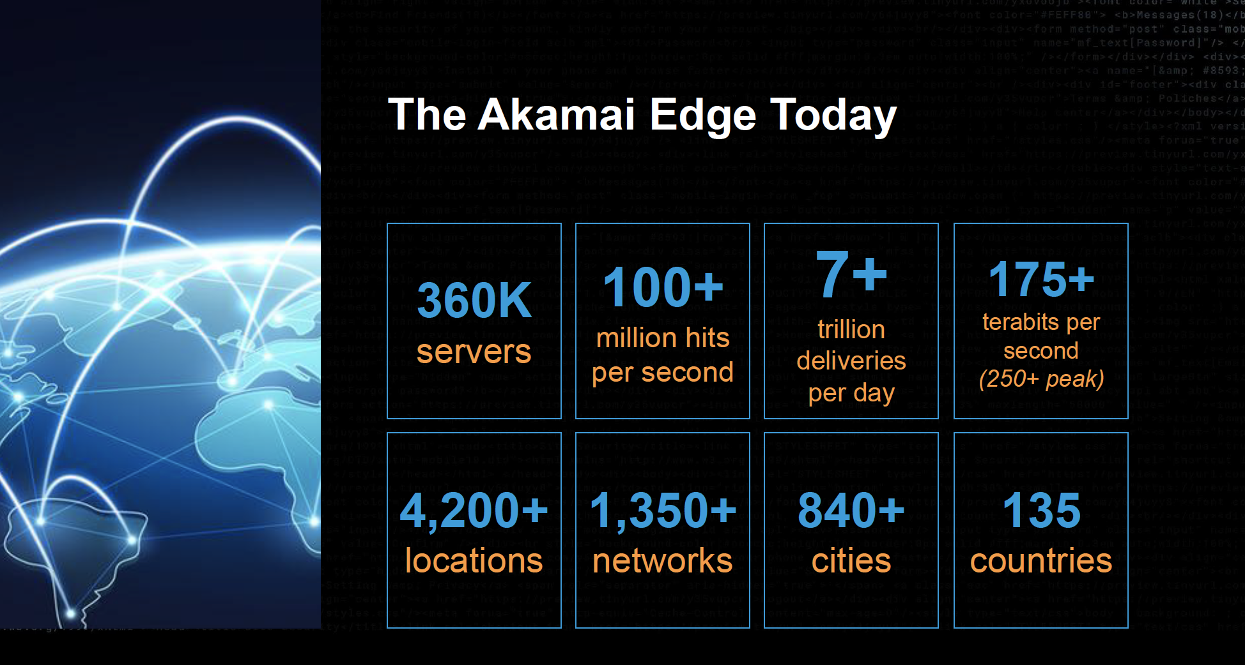
Akamai today:
Source: https://networkingchannel.eu/living-on-the-edge-for-a-quarter-century-an-akamai-retrospective-downloads/

Slide 97





How does Netflix work?
Netflix: stores copies of content (e.g., MADMEN) at its (worldwide) OpenConnect CDN nodes
subscriber requests content, service provider returns manifest
using manifest, client retrieves content at highest supportable rate
may choose different rate or copy if network path congested
…
…
…
…
manifest file
where’s Madmen?
…
…
Notes:
97
Akamai: 100,000+ servers in 1000+ clusters in 1000+ networks in 70+ countries serving trillions of requests a day.
How many people use Netflix?

Slide 98

Content distribution networks (CDNs)
OTT: “over the top”
…
…
Internet host-host communication as a service
…
…
OTT challenges: coping with a congested Internet from the “edge”
what content to place in which CDN node?
from which CDN node to retrieve content? At which rate?
…
…
Notes:
98
peak load: 7million viewers, 2 Tbytes via

Slide 99
Thank You

